Slide 1
Class static data members
We can define class members static using static keyword. When we declare a member of a class as static it means no matter how many objects of the class are created, there is only one copy of the static member.
A static member is shared by all objects of the class.
All static data is initialized to zero when the first object is created, if no other initialization is present.
We can't put it in the class definition but it can be initialized outside the class.

Slide 2
Example
#include <iostream>
Using namespace std;
class Box {
public:
static int objectCount;
// Constructor definition
Box(double l = 2.0, double b = 2.0, double h = 2.0) {
cout <<"Constructor called." << endl;
length = l; breadth = b; height = h;
// Increase every time object is created
objectCount++;
}
double Volume() {
return length * breadth * height;
}
private:
double length; // Length of a box
double breadth; // Breadth of a box
double height; // Height of a box
};
// Initialize static member of class
Box int Box::objectCount = 0;
int main(void) {
Box Box1(3.3, 1.2, 1.5); // Declare box1
Box Box2(8.5, 6.0, 2.0); // Declare box2
// Print total number of objects.
cout << "Total objects: " << Box::objectCount << endl;
return 0;
}

Slide 3
Static Function Members
A static member function can be called even if no objects of the class exist and the static functions are accessed using only the class name and the scope resolution operator ::.
A static member function can only access static data member, other static member functions and any other functions from outside the class.
Static member functions have a class scope and they do not have access to the this pointer of the class. You could use a static member function to determine whether some objects of the class have been created or not.

Slide 4
Default constructor
Default constructor do not take any parameters.
If a default constructor is not provided by the programmer explicitly, then the compiler provides a implicit default constructor.
In that case, the default values of the variables are 0.

Slide 5
Demonstration of default constructor
#include <iostream>
using namespace std;
class A {
private:
int num1, num2 ;
public:
A() {
num1 = 5; num2 = 7;
}
void display() {
cout<<"num1 = "<< num1 <<endl; cout<<"num2 = "<< num2 <<endl;
} };
int main() {
A obj;
obj.display();
return 0;
}

Slide 6
Parameterized Constructor
The parameterized constructor can take arguments to initialize an object when it is created.
Parameters are added to a parameterized constructor just like they are added to a normal function.
The parameterized constructors can be called implicitly or explicitly.

Slide 7
Demonstration of parameterized constructor
#include <iostream>
using namespace std;
class A {
private:
int num1, num2 ;
public:
A(int n1, int n2) {
num1 = n1;
num2 = n2;
}
void display() {
cout<<"num1 = "<< num1 <<endl; cout<<"num2 = "<< num2 <<endl;
} };
int main() {
A obj(3,8);
obj.display();
return 0;
}

Slide 8
Copy Constructor
A copy constructor is a member function that initializes an object using another object of the same class.
A copy constructor has the following general function prototype:
ClassName (ClassName &old_obj);
Copy constructor is used to initialize the members of a newly created object by copying the members of an already existing object.
Copy constructor takes a reference to an object of the same class as an argument.
Sample(Sample &t)
{
id=t.id;
}
The copy constructor can be defined explicitly by the programmer. If the programmer does not define the copy constructor, the compiler does it for us.

Slide 9
Demonstration of copy constructor
class Point {
private:
int x, y;
public:
Point(int x1, int y1)
{
x = x1;
y = y1;
}
// Copy constructor
Point(const Point& p1)
{
x = p1.x;
y = p1.y;
}
int getX() { return x; }
int getY() { return y; }
};
int main()
{
Point p1(10, 15); // Normal constructor is called here
Point p2 = p1; // Copy constructor is called here
// Let us access values assigned by constructors
cout << "p1.x = " << p1.getX()
<< ", p1.y = " << p1.getY();
cout << "\np2.x = " << p2.getX()
<< ", p2.y = " << p2.getY();
return 0;}

Slide 10
Demonstration of copy constructor
#include <iostream>
using namespace std;
class A
{
public:
int x;
A(int a) // parameterized constructor.
{
x=a;
}
A(A &i) // copy constructor
{
x = i.x;
}
};
int main()
{
A a1(20); // Calling the parameterized constructor.
A a2(a1); // Calling the copy constructor.
cout<<a2.x;
return 0; }

Slide 11
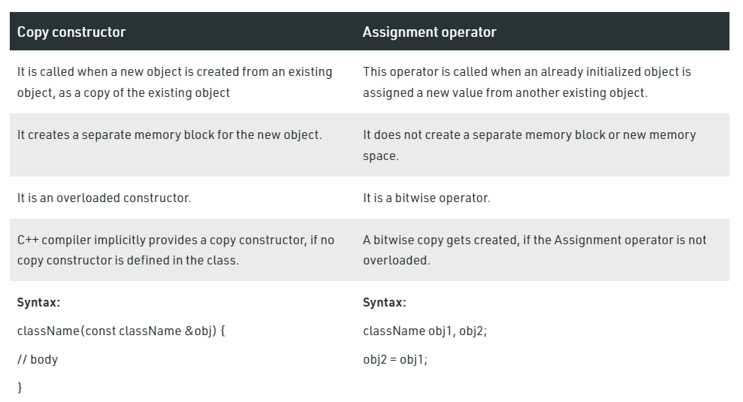
Difference between Copy Constructor and Assignment Operator

Slide 12
Implicit and Explicit calling of Constructor
Implicit constructor is that which is provided by default in a class and explicit constructor is that which we specify explicitly in our class.
If we provide constructor explicitly then there is no implicit constructor provided by the compiler and if there is no explicit constructor then compiler will provide implicit constructor.

Slide 13
Example
Class Sample
{
Sample(int)
{…..}
};
int main(){
Sample s = sample (20); //Explicit constructor
Sample s(20); //Implicit constructor
Return 0
}

Slide 14
Destructor
A destructor is a special member function of a class that is executed whenever an object of it's class goes out of scope or whenever the delete expression is applied to a pointer to the object of that class.
A destructor will have exact same name as the class prefixed with a tilde (~) and it can neither return a value nor can it take any parameters. Destructor can be very useful for releasing resources before coming out of the program like closing files, releasing memories etc.

Slide 15
Example
#include <iostream>
using namespace std;
class Line {
public:
void setLength( double len );
double getLength( void );
Line(); // This is the constructor declaration
~Line(); // This is the destructor: declaration
private: double length; };
// Member functions definitions including constructor
Line::Line(void) {
cout << "Object is being created" << endl;
}
Line::~Line(void) {
cout << "Object is being deleted" << endl;
}
void Line::setLength( double len ) {
length = len;
}
double Line::getLength( void )
{
return length;
}
// Main function for the program
int main() {
Line line;
// set line length
line.setLength(6.0);
cout << "Length of line : " << line.getLength() <<endl;
return 0; }

